Slide 1
PRESENTATION
STYLE GUIDE
2014
Principles and Fundamentals
Delivery to : Phase One Team
00.00.0000

Slide 2
Web Mocks

Slide 3

Subtitle (Enter Text)

Slide 4
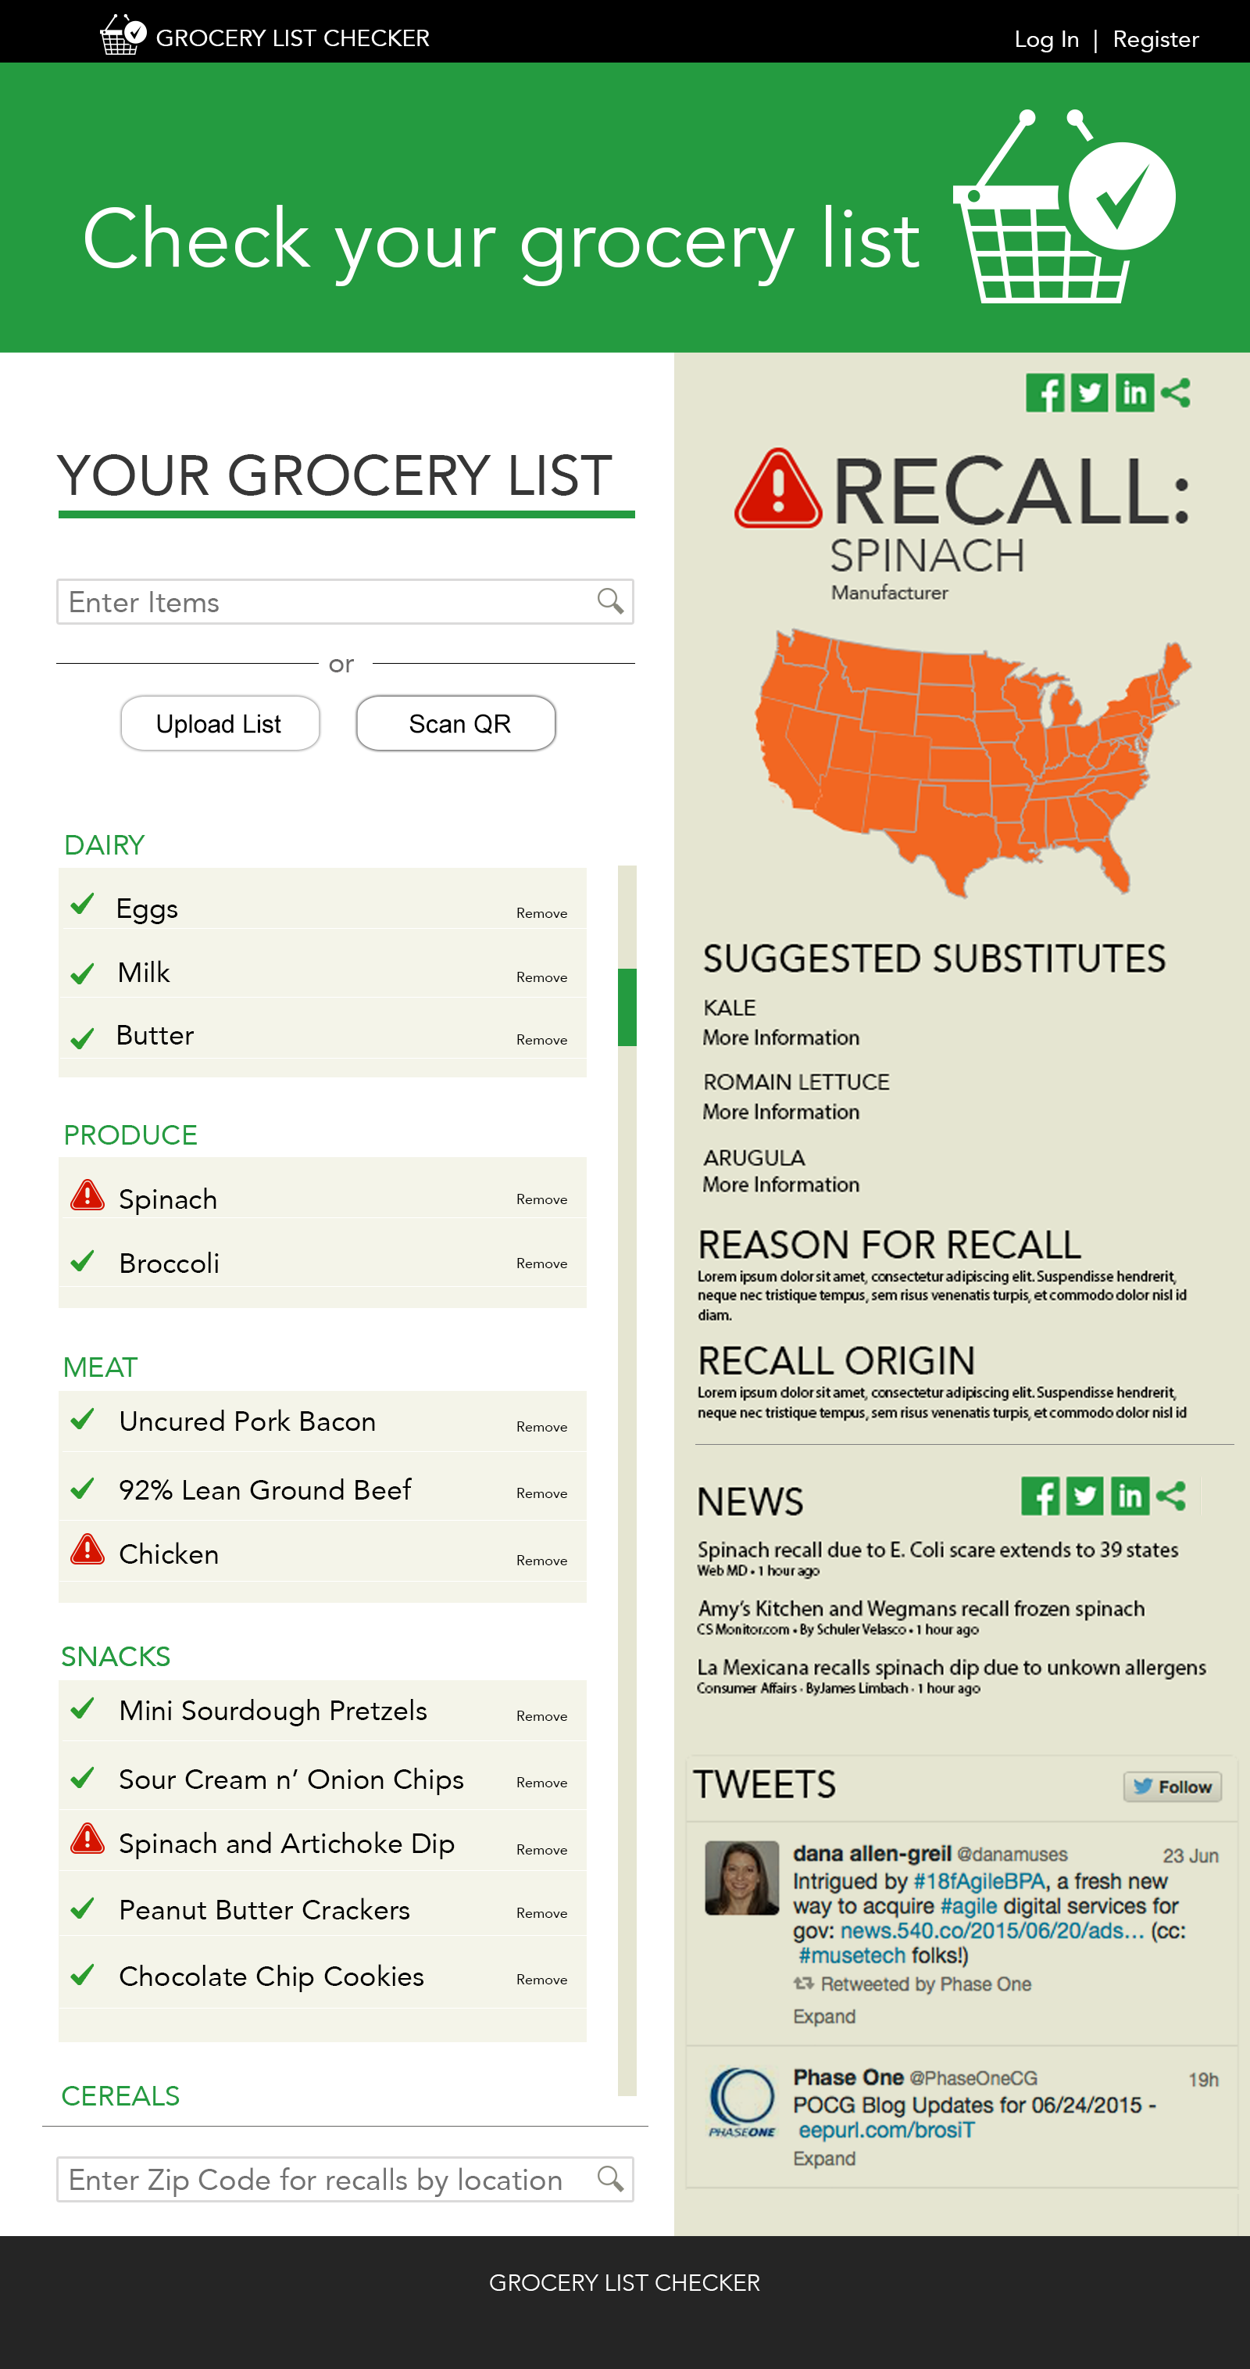
List and Recall Detail Page

Slide 5
Mobile Mocks

Slide 6

Mobile Landing

Slide 7
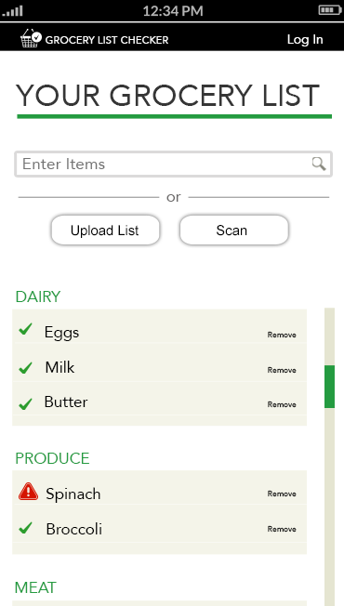
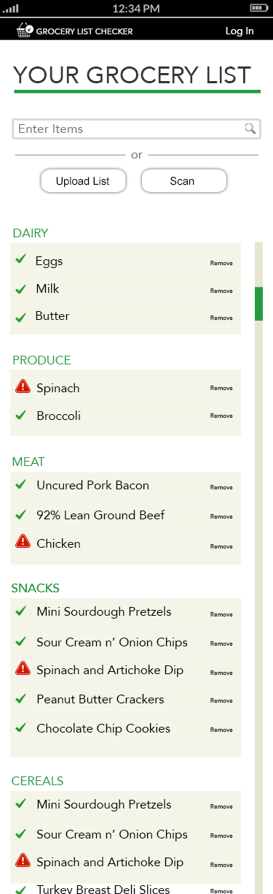
List Page (Left is shows down to the fold)

Slide 8


Recall Details section (left shows down to the fold)

Slide 9
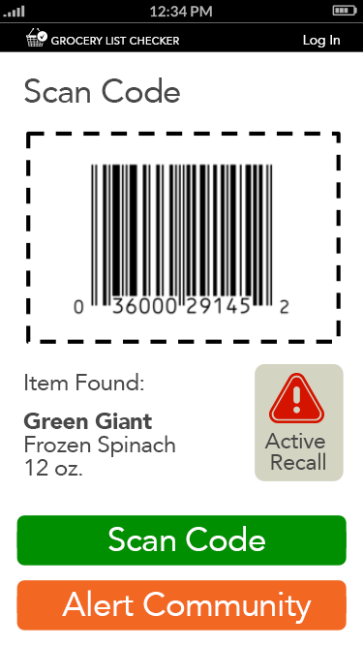
Scan section

Slide 10
Questions?
?

